Slide 1
Contributing to Django
How I learned to stop worrying and just try to fix an ORM Bug
Notes:
Talk slowly

Slide 2
First DjangoCon?
Notes:
Talk slowly
How many people are attending their first DjangoCon
ACTION: Get a drink of water

Slide 3
Introduction
Notes:
My name is Ryan Cheley.
I work for a Medical Services Organization in Southern California.
Part of my duties include managing a team of web developers and one of our newer projects is an internal Django App
Today I’m going to talk about the fantastic experience I had in trying to fix a bug in the Django ORM
ACTION: Get a drink of water
But first, a side quest

Slide 4
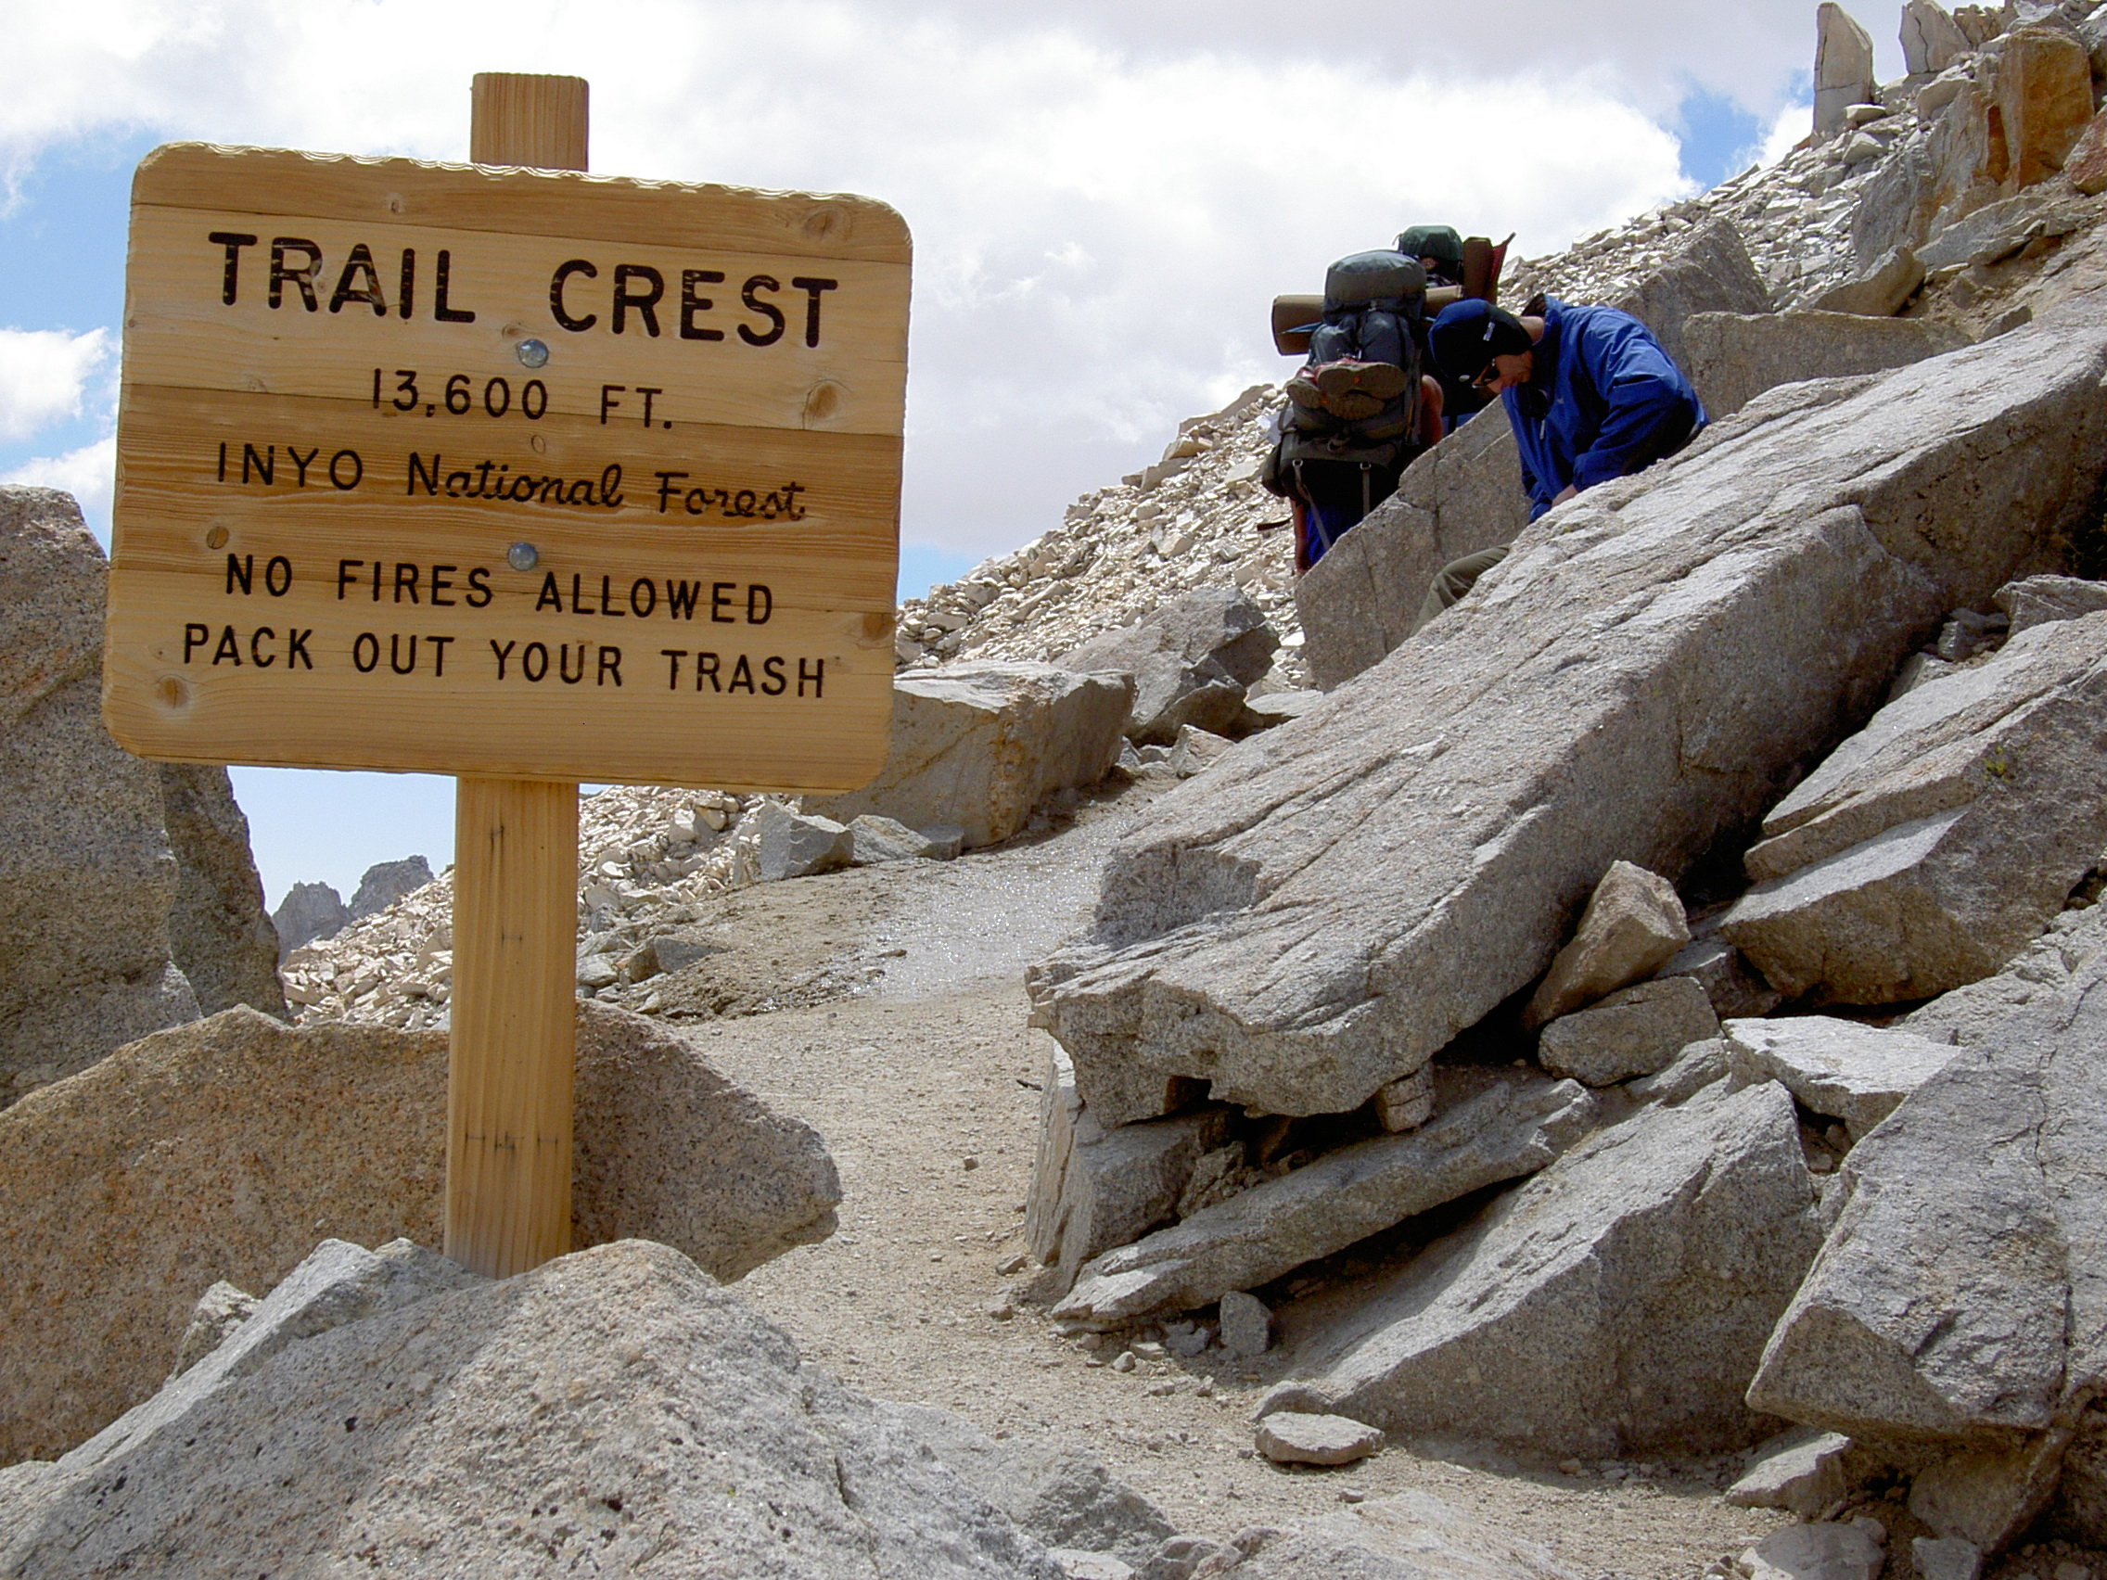
Notes:
When I was 15 (in 1993) my Boy Scout troop did a trip to Mt Whitney.
There I was ... at the top of the Mt Whitney Portal, 13,600 ft (4159 m) above sea level
I had spent the 7 days hiking to get here.
ACTION: Drink Water
I was only 3 miles from the summit of Mt Whitney ... but I wasn't sure I could go any further.
My hiking companions told me I didn't look so good. Truth be told, I didn't feel so good either.
Did I make it to the summit?

Slide 5
Trying to get to DjangoCon US
2018
2019
2020
2021
2022
💼
💼
🦠
🧑🏻‍💻
🧍🏻
🎉
Notes:
I’ve been trying to make it to DjangoCon US since 2018
2018: But, I had a work conference I had to attend.
2019: It happened again in 2019
2020: I was *determined* to go in 2020 ... but we all know what happened there
2021: I was able to attend the online version in 2021
2022: And then I finally made it in person 2022 … And it was amazing.

Slide 6
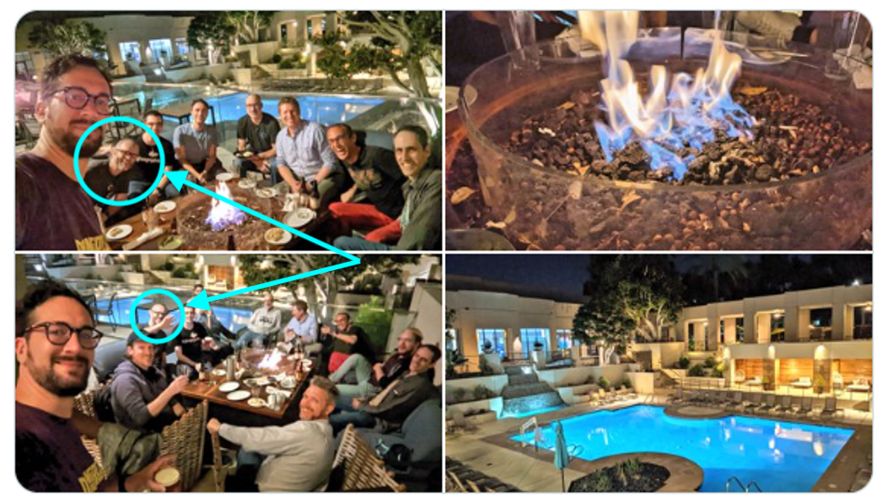
Notes:
ACTION: Take a sip of water
You can see me in the pictures on the left … I had *slightly* longer hair then ☺

Slide 7
🏃🏻‍♂️
Notes:
Sprints
I was very excited about attending the sprints and working on *something* (ACTION: Wave your arms) ORM related
My strategy for finding a ticket was to find something old, that seemed straightforward(ish) and then just go for it.
I spent some time during the conference
trying to find something,
and by the day of the sprints
I had been able to narrow it down
to a single ticket

Slide 8
Criteria
Old?
It was opened in January of 2009
Straightforard(ish)
It’s related to SQLite
Ticket 10070
Named parameters not working on raw sql queries with sqlite
Reported by Matias Surdi

Slide 9
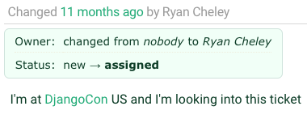
Notes:
I assigned the ticket to myself
ACTION: take a sip of water

Slide 10
🔍
Notes:
Reviewing the Ticket
I spent time reviewing the ticket
Then I spoke with Simon Charette about it.
It *seemed* as though it wasn't a problem anymore

Slide 11
My Trac Comment
In looking at the tests in raw_query\tests I see a few tests that already exist
These are already available and appear to be testing the very thing that the ticket is asking for.
Notes:
And so I added a comment to the ticket

Slide 12
🎉
Notes:
Marking the Ticket as Done!

Slide 13
Comment
Thanks for looking into this. I can get back to work now :)
By Matias Surdi
The Reporter of the Issue!
Notes:
A comment on the issue thanking me for working on the ticket … the original reporter for the ticket!

Slide 14
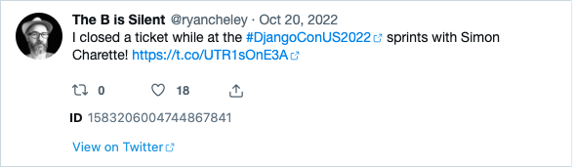
Letting everyone know!
Notes:
I was so excited that I let the world know about it on Twitter / X
ACTION: take a sip of water

Slide 15
🏠
Notes:
I spent the rest of my time at the sprints
working on other
non-ORM related tickets
in other Django related projects
When it was all over
I headed home
having been able to fix a bug
in the ORM!!!!
ACTION: Take a sip of water

Slide 16

Notes:
And I felt *really* good about this
This is a scene from the James Cameron movie Titanic (released December 19, 1997) when Leonardo Dicaprio’s character says, “I’m the king of the world!”
Funny Story … I’ve never seen this movie

Slide 17
But then …

Slide 18
Another Comment
Sorry -- this is still broken on Sqlite. The additions and fixes mentioned are mostly for Oracle and other backends. The Sqlite backend, at the time I write this, still has
supports_paramstyle_pyformat = False
and still borks with a syntax error if you try to replicate the session in the ticket description.
By Shia Berger
Notes:
Shai Berger is a member of the Django Security team

Slide 19
😩
Notes:
Oh No!
I was faced with two potential choices:

Slide 20
🙈🙉🙊
Notes:
Ignore the bug. It had been a bug for YEARS … it was opened on January 19, 2009 (13 YEARS!!!!) and didn’t seem to have caused any MAJOR issues

Slide 21
🛠️
Notes:
Fix
Try to work it on my “own”

Slide 22
Feelings …
Notes:
I also had lots of feelings surrounding the discovery of the bug still existing

Slide 23
😳
Notes:
Embarrassed
I declared it fixed on Twitter
I had people at the DjangoCon Sprints ASK ME HOW I DID IT!
ACTION: Take a sip of water

Slide 24
😞
Notes:
Disappointed
I felt like I let people down
I felt like I let *myself* down

Slide 25
😨
Notes:
Fear
Imposter Syndrome – Can I work on this on “my own”
ACTION: Take a sip of water

Slide 26
Community
Notes:
But then I remembered a talk that Carlton Gibson gave
at DjangoCon US 2018
Entitled
“Your Web Framework Needs You”.
It's a great talk and you should totally watch it,
but here are the highlights that I got out of it

Slide 27
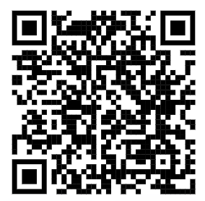
Your Web Framework Needs You!
Ticket difficulty
The Review Process can be challenging
You can do it!
Notes:
1. The vast majority of tickets are no harder than the work you do to solve every single day using Django
a. Yes they need, time, thought, and a little bit of your love
b. If you get stuck while trying to solve it you can ask for help!
ACTION: take a sip of water
2. The review process is hard
a. … and everyone gets the same review process;
b. it’s not personal
ACTION: take a sip of water
3. You can do it.
a. You are qualified!
b. If you’ve spent time working on an issue you are (ACTION: go to Next Slide)

Slide 28
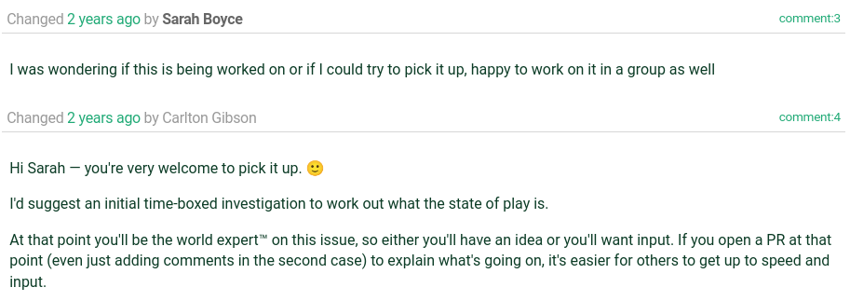
The World’s Foremost Expert

Slide 29
Working on the Ticket
Notes:
I went to work on the ticket and did what most of us do when we’re assigned a Bug for work, or on a personal project

Slide 30
Replicate the Bug 🐛
Read some docs 📖
Write some code ✍🏻
Test the Code 🧪
Write down what you learned 📜

Slide 31
🐛
Notes:
Replicate the Bug

Slide 32
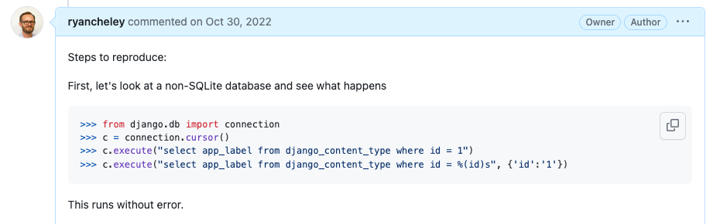
Notes:
In this case I was running against a Postgres database

Slide 33
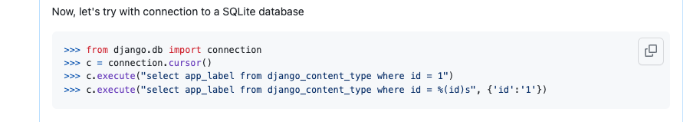

Slide 34
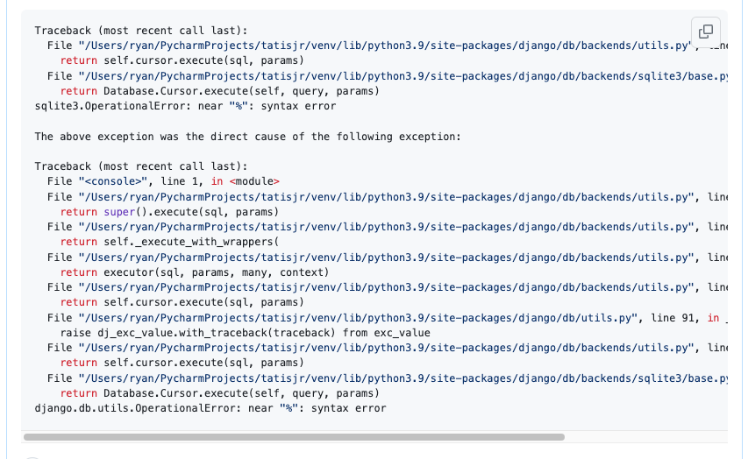

Slide 35
📖
Notes:
Read some docs

Slide 36
Results of Research
Django uses "format" style placeholders,
pysqlite2 uses "qmark" style.
if you want to use a literal "%s" in a query, you'll need to use "%%s".

Slide 37
✍🏻
Notes:
Write some code

Slide 38
Ideas for a fix
Use a Regular expression!
Notes:
But as the (paraphrased) saying goes, I had a problem so I used a Regular Expression and now I have two problems - Jamie Zawinski

Slide 39
My Regular Expression
query = re.sub("\)s", "", re.sub("%\(", ":", query))
Notes:
But as the (paraphrased) saying goes, I had a problem so I used a Regular Expression and now I have two problems - Jamie Zawinski

Slide 40
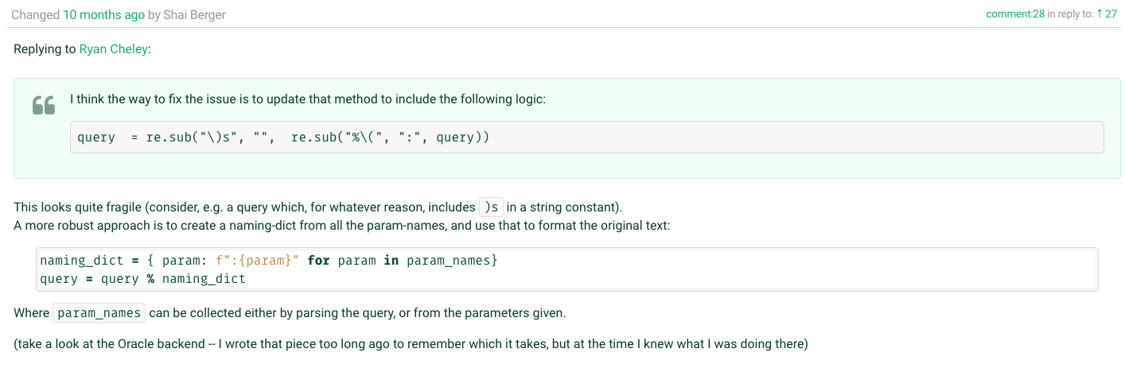

Slide 41
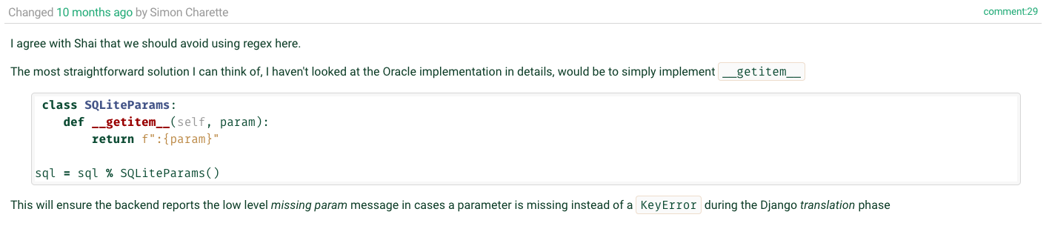

Slide 42
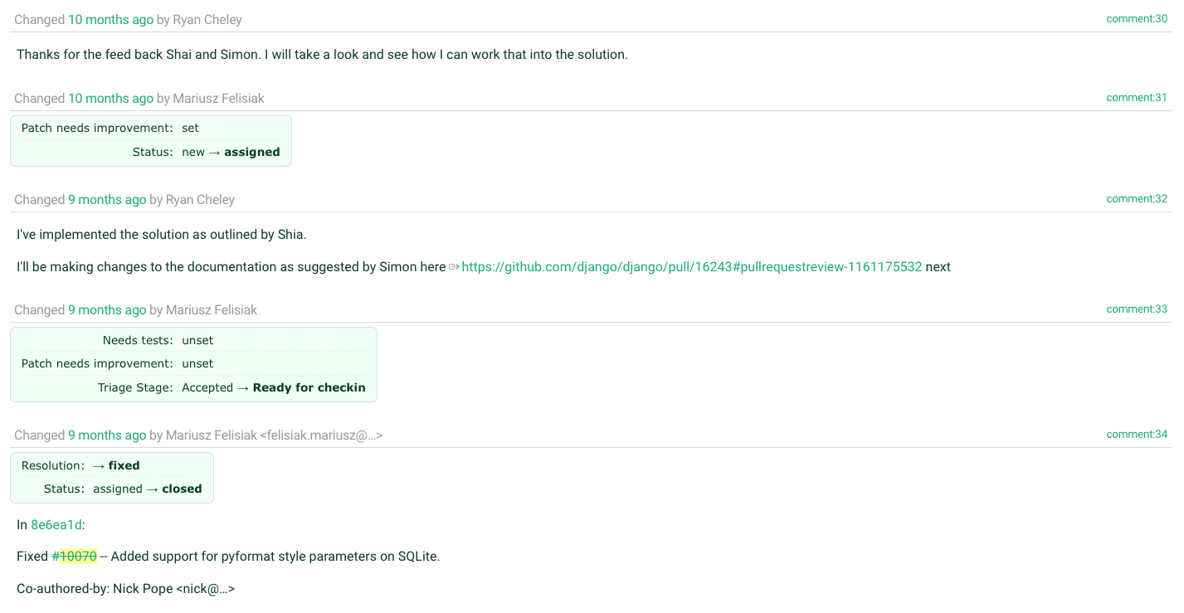

Slide 43
🧪
Notes:
Test the code that you wrote

Slide 44
Testing Hypothesis Matrix
 | Flag = False | Flag = True
Original Code | N-1 Tests Should pass 1 test should be skipped | N-1 Tests Should pass 1 test should fail
Updated Code | N-1 Tests Should pass 1 test should be skipped | All tests should pass
*Flag = supports_paramstyle_pyformat

Slide 45
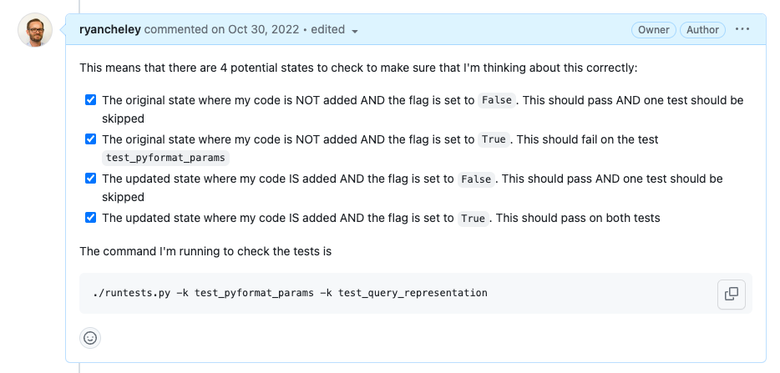
Notes:
Four States to check
The original state where my code is NOT added AND the flag is set to False. This should pass AND one test should be skipped
The original state where my code is NOT added AND the flag is set to True. This should fail on the test test_pyformat_params
The updated state where my code IS added AND the flag is set to False. This should pass AND one test should be skipped
The updated state where my code IS added AND the flag is set to True. This should pass on both tests

Slide 46
📜
Notes:
Write down what you’re learning as you’re learning … because we all do this, right?
I didn’t, until I saw this talk by Simon Willison at DjangoCon US 2022 titled, “Massively increase your productivity on personal projects with comprehensive documentation and automated tests”

Slide 47
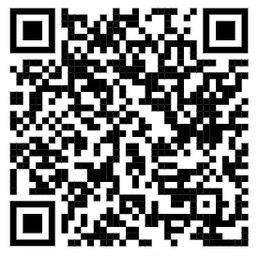
Public Notes
Notes:
At DjangoCon US 2022 Simon Willison gave a great talk which included an idea called ‘public notes’. I highly recommend watching that talk and implementing the public notes idea
This was the first time I used the idea, but I've used it a few more times since then as I try to learn about a thing. I’ve even started doing it at my joby-job
Essentially you use an issue (in this case a GitHub issue) as a spot to work through a problem and leave yourself breadcrumbs for what you’ve tried and learned, basically doing what you would do in the ‘scientific method’

Slide 48
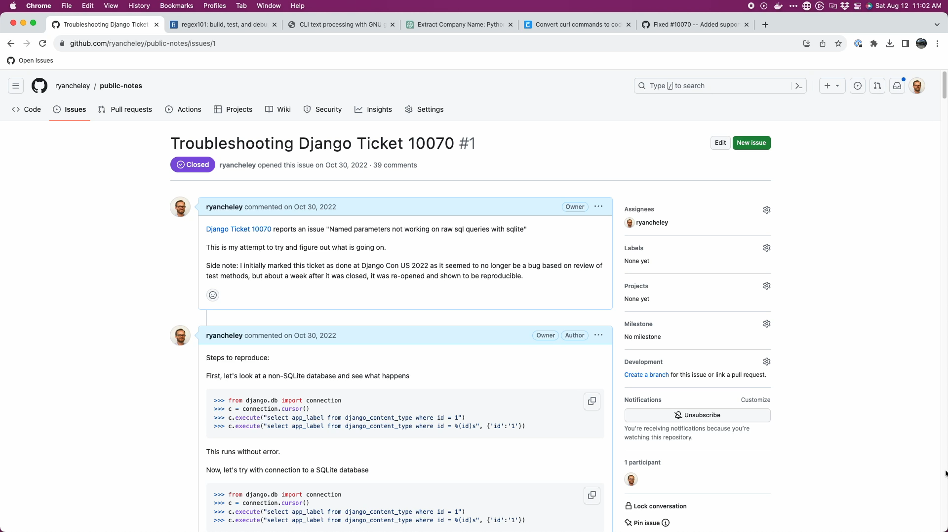
Notes:
40 comments as a conversation to myself, back and forth from Oct 30, 2022 to Nov 8, 2022 (10 days!)

Slide 49
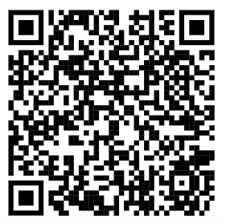
My Public Notes
Notes:
In my notes there’s a lot of back and forth, two steps backward, 1 step forward kind of things, but even looking at it now, I can see my thought process for how the bug ended up getting fixed

Slide 50
The fix
Notes:
Ultimately the fix was made, but it wasn’t just *me*. I had a lot of help in getting the code to the right spot.
Nick Pope
Shia Berger
Simon Charette
Mariusz Felisiak

Slide 51

Nick Pope

Slide 52
Remove Code Duplication
%(value)s to :value
generators
Notes:
There is duplication which should be pushed down into .convert_query().
Converting %(value)s to :value in this way will also convert %%s to %s which will then be incorrectly converted to ? in .convert_query(). We should not perform both conversions¹ and a test should be added to ensure this doesn't happen.
Converting param_list to a list in .executemany() will saddle us with poor performance. We many have been passed a generator and the current approach will force all of the parameters to be materialized. The approach needed requires that we can peek at the first item in the generator without consuming the lot.

Slide 53
Shia Berger

Slide 54
Identified fragility
Notes:
Feedback that the approach had some fragility https://code.djangoproject.com/ticket/10070#comment:28
with Simon Charette agreeing https://code.djangoproject.com/ticket/10070#comment:29
And that regex should be avoided

Slide 55

Simon Charette

Slide 56
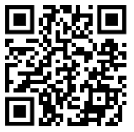
Gave great Keynote at DjangoCon US 2022 on the State of the ORM
Awesome primer on ORM at Sprints
Update to the docs!
Notes:
He gave a great keynote at DjangoCon US 2022
And an awesome primer on the ORM in general at the sprints
Remember to update the docs!

Slide 57

Mariusz Felisiak

Slide 58
Simplified comments
Merged the PR

Slide 59
Lessons

Slide 60
The ORM can seem BIG and Scary
Notes:
The ORM can seem big and scary
The code for Django can seem big and scary

Slide 61
The Code for Django can seem BIG and Scary
Notes:
The ORM can seem big and scary
The code for Django can seem big and scary

Slide 62
But remember
Notes:
The ORM can seem big and scary
The code for Django can seem big and scary

Slide 63
The Django ORM …

Slide 64
Is Python

Slide 65
In fact, all of Django …

Slide 66
Is Python

Slide 67
Looking at Tickets
Notes:
So when you go to look for a ticket to take, remember that there is an amazing community here that wants to see you succeed …

Slide 68
Look At
Read
Write
Notes:
and at the end of the day the code you’re going to look at, read, and write

Slide 69
Is Python

Slide 70
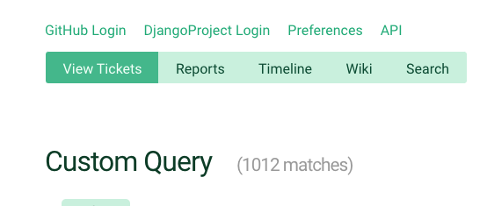
Notes:
So when you’re ready to dive in to one of the currently <> open tickets, just keep that in mind

Slide 71
Notes:
This is where I will put other OSS accomplishments
- updated docs on DjangoPackages
-

Slide 72
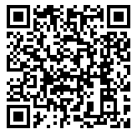
Trac
Notes:
And because this is Django, there is great documentation on how to triage tickets and work through them

Slide 73
Notes:
Back to Mt Whitney
I was **only** three miles from the summit, but I just wasn’t feeling **it**.
My fellow hikers didn’t discourage me from continuing, but they didn’t really encourage me either.
I didn’t make it to the summit that day and it’s been a regret ever since. I’ve not attempted another big hike
But why am I telling this story? What does this have to do with fixing a bug in the Django ORM.
When the bug wasn’t resolved I had an option to ignore it / give up. I could have NOT gone to the summit of the BUG
But the community helped me to work through it. The solution that was ultimately submitted and merged wasn’t just mine, it was through the hard work of a couple of different people.
This community wants you to succeed. They want you to learn.
If this community had been up there with me that day, I’m 100% sure that I would have made it to the summit because of the encouragement that is provided and the determination to want **you** to succeed

Slide 74
So remember …

Slide 75
Your Framework needs YOU

Slide 76
Community
Notes:
And there’s a great community to support you and wants to see you succeed and learn

Slide 77
Thank you

Slide 78
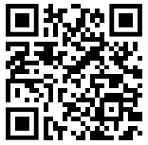

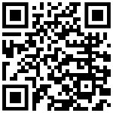
Find me on …
Platform | QR Code
Mastodon https://mastodon.social/@ryancheley
GitHub https://github.com/ryancheley/
LinkedIn https://www.linkedin.com/in/ryan-cheley/

